Slide 1
UAT Report: J107 Flashing & Diagnostics Using Mahle EOL Diagnostic System
Runtime: 3.1.2.0
Calibration Version: MB-N600-0126-P5.232

Slide 2
Abstract
This report presents the successful completion of the J107 End-of-Line (EOL) Flashing & Diagnostics implementation using the Mahle Diagnostic Platform, with the primary objective of standardizing and optimizing the EOL test sequence for the J107 model at TVS Motor Company – Plant 2, Hosur.
The scope of the project included improvement in Productivity, Efficiency, Streamlining Diagnostic operations in the Plant.

Slide 3
Project Team Structure & Work Area
Work Area
Plant 2 VA – EOL
(2VCON600)
Team Members
PED Hosur:
  J Somasundar
  Mallamma M Pujar
  Peethala Rajiv Roy
  Arjun PV
PED SP Hosur:
  Nithish V
  T Sathiya Narayanan
OPNS Plant 2:
  NKP
  Parasuram

Slide 4
EOL Process Flow
Current EOL Flow
J107 EOL Flow
2VCON600
Vehicle Assy
2VCON600
Vehicle Assy
IMU
Flashing
RTB
ABS Flashing
ABS Brake Test
Static
RVS
VCU Flashing
RTB
IMU
T4 Booking
PCM Flashing
RVS
ABS Brake Test
Static
T4 Booking

Slide 5
SKU vs Features Matrix
Features | J107 ECE Base | J107 ECE Top | J107 India Base | J107 India Tech pack | J107 India Tour pack
Adjustable FR and RR suspension | P | P | P | P | P
MFR / projector Lamp | P | P | P | P | P
Signature DRL | P | P | P | P | P
Dynamic Headlamp | P | P | O | P | O
Signature welcome sequence | P | P | P | P | P
Take me home | P | P | P | P | P
Take me bike | P | P | P | P | P
Cornering lamp | O | P | O | P | O
Carpet Lamp ( Puddle lamp) | O | P | O | P | O
TFT (8" Touch Screen with Unique Norton UI UX) | P | P | P | P | P
Multimedia control - Calling, Music etc., | P | P | P | P | P
Turn by turn navigation, Live location tracking | P | P | P | P | P
Multiway connectivity - Helmet / Cluster / Mobile / Smart watch | P | P | P | P | P
Voice Assist, Telematics, Remote immobilization & geo-fencing | P | P | P | P | P
Go-pro control, F-OTA | P | P | P | P | P
5 Ride Modes - Rain, Urban, Tour, Enduro, Rider configurable Engine - 2 ABS - 3 | P | P | P | P | P
TPMS | P | P | O | P | O
Keyless Entry - Ignition, tank cap and Seat | P | P | P | P | P
USB Charger - C Type | P | P | P | P | P
Heated grips | O | P | O | P | O
Heated Seat | O | P | O | P | O

Slide 6
SKU vs Features Matrix
Features | J107 ECE Base | J107 ECE Top | J107 India Base | J107 India Tech pack | J107 India Tour pack
Gear Shift assist / Quickshifter | P | P | P | P | P
Adjustable hand brake lever / clutch lever | P | P | P | P | P
Rally Footpeg (Extra wide) | P | P | P | P | P
Adjustable foot brake lever | P | P | P | P | P
Adjustable gear lever / peg | P | P | P | P | P
Rear Grab Handles / Rear rack | O | P | O | O | P
Easy adjustable windshield | O | P | O | O | P
Switchable rear ABS | P | P | P | P | P
Linear Traction Control | P | P | P | P | P
Cruise Control | P | P | P | P | P
Cornering cruise control | P | P | P | P | P
Cornering Traction Control | P | P | P | P | P
Hill-hold Assist, Vehicle-hold Control, eCBS | O | P | O | P | O
Slope dependant control | P | P | P | P | P
Telematics | P | P | P | P | P
Unique Norton Companion App Ux/Ui : (Journey Tracking, Location GeoFence/SMS Alert, Condition Status/Service Alert) | P | P | P | P | P
Live location tracking | P | P | P | P | P
Remote immobilization | P | P | P | P | P
Geo-fencing | P | P | P | P | P
Theft alert Tow-Away alert | P | P | P | P | P
F-OTA | P | P | P | P | P
Voice control | P | P | P | P | P

Slide 7
SKU List
 | 10.3 MB ABS | 10.3 MEFI ABS | 10.3 MB ABS | 10.3 MEFI ABS | 10.3 MB ABS
Features | J107 ECE Base (BASE) | J107 ECE Top (TOP) | J107 India Base (BASE) | J107 India Tech pack (BTO 1 - TOP) | J107 India Tour pack (BTO 2 - BASE)
Dynamic Headlamp | P | P | O | P | O
Cornering lamp | O | P | O | P | O
Carpet Lamp ( Puddle lamp) | O | P | O | P | O
TPMS | P | P | O | P | O
 | NMJ1190030GB0D | NMJ1190040GB0D | NMJ1190090IN0D | NMJ1190100IN0D | NMJ1190110IN0D
 | NMJ1190030GBQN | NMJ1190040GBQN | NMJ1190090INQN | NMJ1190100INQN | NMJ1190110INQN
 | NMJ1190030GBSL | NMJ1190040GBSL | NMJ1190090INSL | NMJ1190100INSL | NMJ1190110INSL
 | NMJ1190030GBNN | NMJ1190040GBNN | NMJ1190090INNN | NMJ1190100INNN | NMJ1190110INNN
 | NMJ1190170US0D | NMJ1190040GBBN |  | NMJ1190100INBN | NMJ1190110INBN
 | NMJ1190170USQN | NMJ1190180US0D
 | NMJ1190170USSL | NMJ1190180USQN
 | NMJ1190170USNN | NMJ1190180USSL
 |  | NMJ1190180USNN
 |  | NMJ1190180USBN

Slide 8
ABS FLASHING

Slide 9
Bosch 10.3MB / MEFI ABS Flashing Sequence
Expected Cycle Time: 25 – 30s
Start
Connect Cable
Ignition ON
Scan VIN number
Set ALL
Stations = Null
ABS Extended
Diag Session
ABS Default
Session
Get ABS Flash
File details
Get Veh Data thru API
Start Comm. ABS
ABS Flashing
ABS SW Version Check
Read CAL ID & Compare
Read BB no. & Compare
Write VIN
Log Result
Clear DTC
Read VIN
Write Vehicle Variant
Enable IMU
Feature
Send Result thru API
Stop

Slide 10
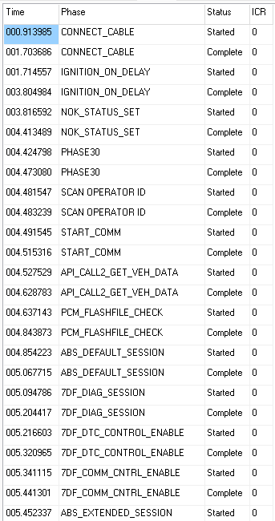
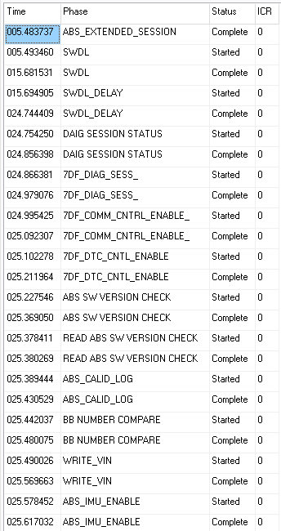
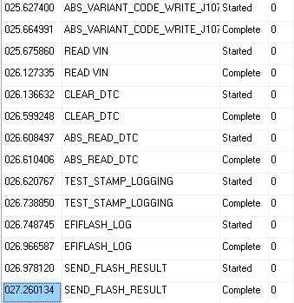
Test Verification - Phases

Slide 11
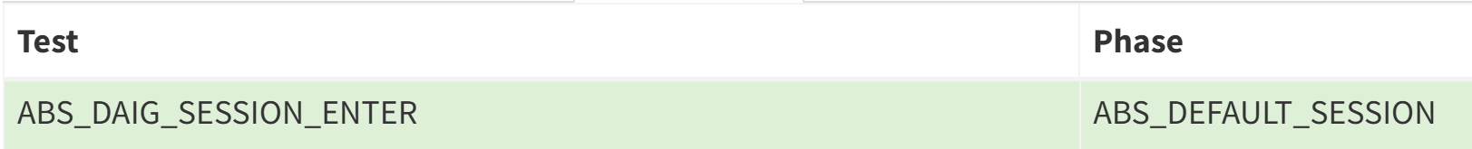
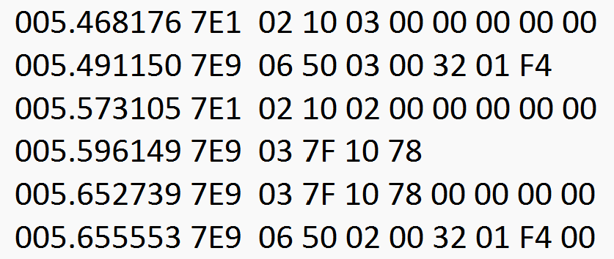
Test Verification
HECU – Diagnostic Session tests:
Log File
Request
Response
Request
Response

Slide 12
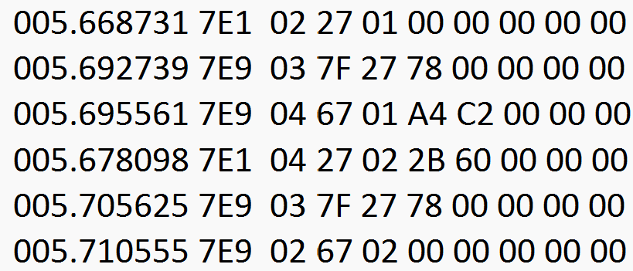
Test Verification
HECU – Seed & Key tests:
Log File
Request
Response
Request
Response

Slide 13
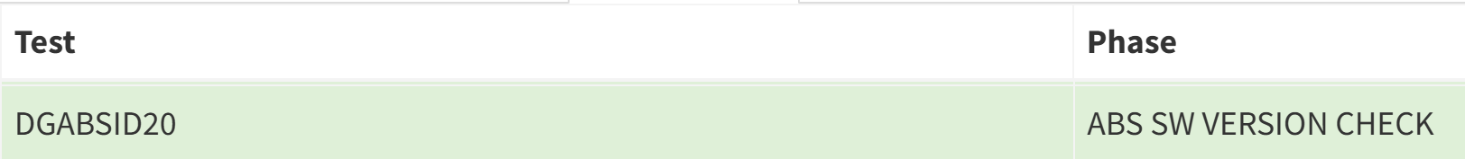
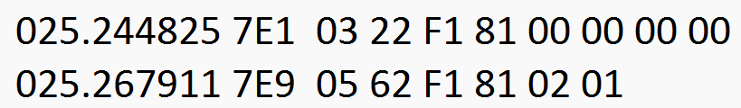
Test Verification
HECU – Read Software Version:
Log File:
Request
Response
Report Logiq:

Slide 14
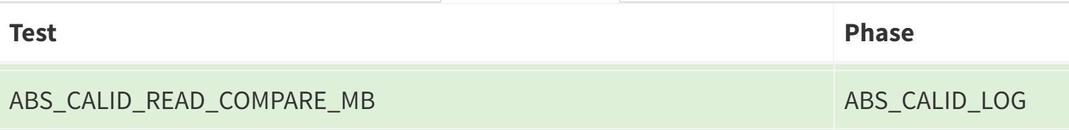
Test Verification
HECU – Read & Compare CAL ID:
Log File:
Request
Response
Report Logiq:

Slide 15
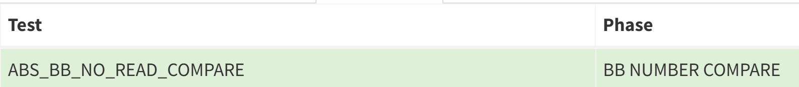
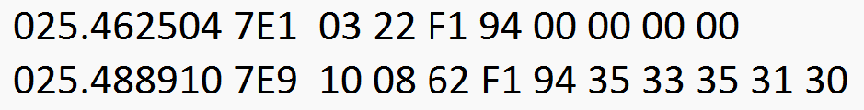
Test Verification
HECU – Read & Compare BB number:
Log File:
Request
Response
Report Logiq:

Slide 16
Test Verification
HECU – Write VIN:
Log File:
Request
Response
Report Logiq:

Slide 17
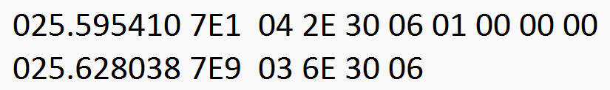
Test Verification
HECU – Enable IMU Feature:
Log File:
Request
Response
Report Logiq:

Slide 18
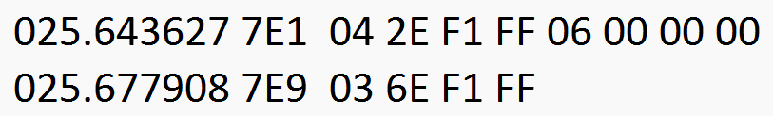
Test Verification
HECU – Write Vehicle Variant:
Log File:
Request
Response

Slide 19
Test Verification
HECU – Read VIN:
Log File:
Request
Response
Report Logiq:

Slide 20
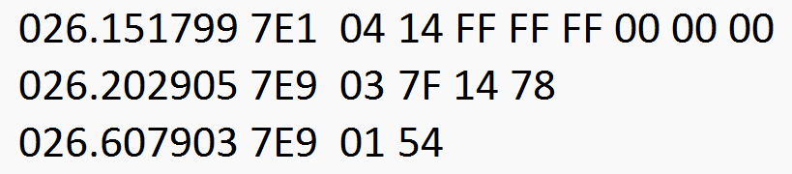
Test Verification
HECU – Clear DTC:
Log File:
Request
Response

Slide 21
VCU FLASHING

Slide 22
VCU Flashing Sequence
Expected Cycle Time: 55 – 60s
Start
Connect Cable
Ignition ON
Scan VIN number
Set ALL
Stations = Null
Read VCU Bootloader
Get VCU Flash
File details
Get Vehicle Data thru API
Start Comm. VCU
Check ABS Flashing = OK
Compare VCU Bootloader
VCU Default
Session
VCU Diagnostic Session
VCU Extended
Diag Session
VCU Flashing
Read VCU Application Ver
Read VIN
Read SKU
Write SKU
Write VIN
Read & Compare CVN
Write & Read
Key Fob MAC ID
Write Secret Key
Into EMS
Write Secret Key
Into IPC
Write Secret Key
Into VCU
Stop
Send Result thru API
Log result
Log result
Clear DTC

Slide 23
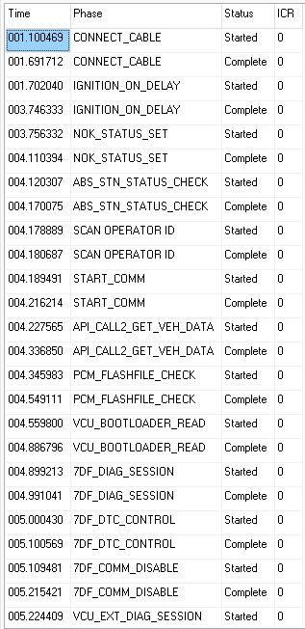
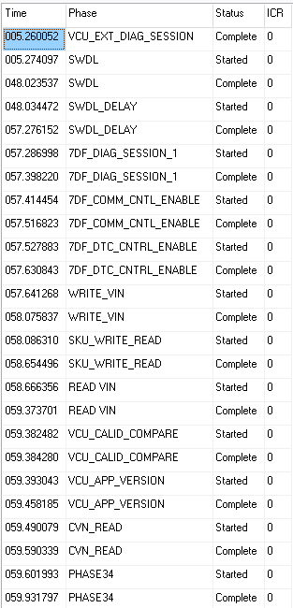
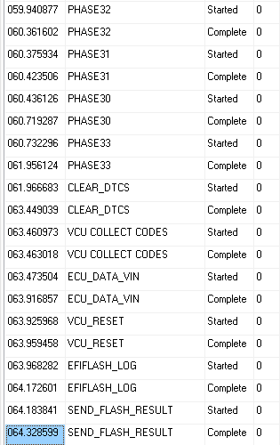
Test Verification - Phases

Slide 24
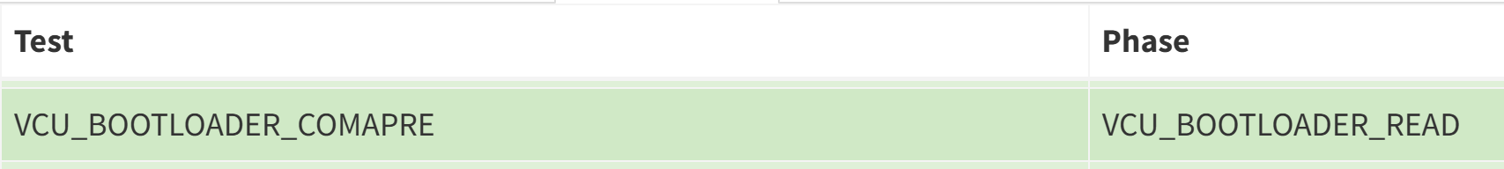
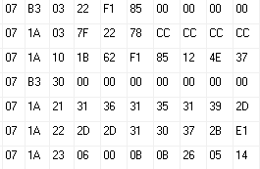
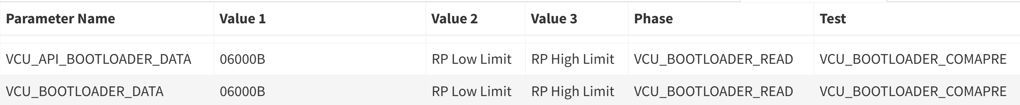
Test Verification
VCU – Read & Compare Bootloader Version:
Log File
Request
Response
Report Logiq:

Slide 25
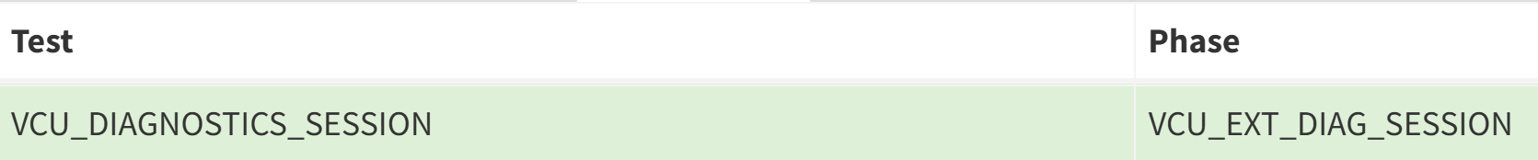
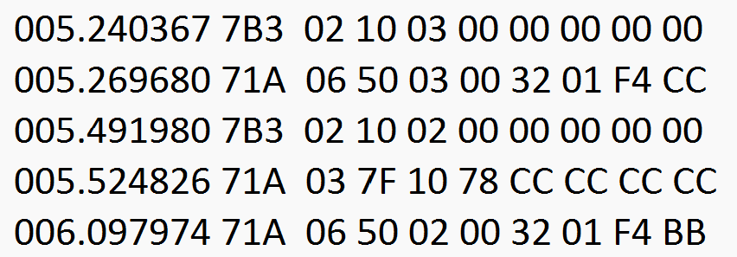
Test Verification
VCU – Diagnostic Session tests:
Log File
Request
Response
Request
Response

Slide 26
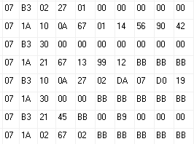
Test Verification
VCU – Seed & Key tests:
Log File
Request
Response
Request
Response

Slide 27
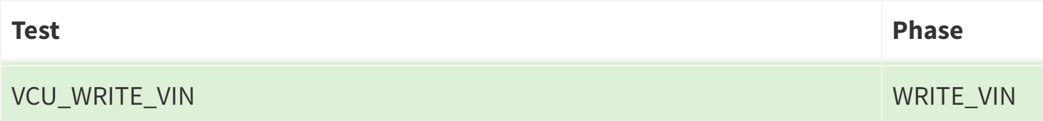
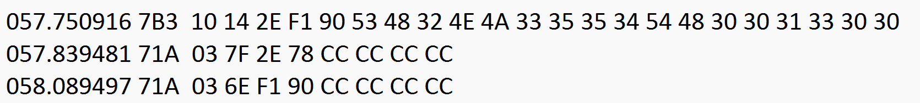
Test Verification
VCU – Write VIN:
Log File:
Request
Response
Report Logiq:

Slide 28
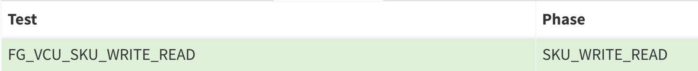
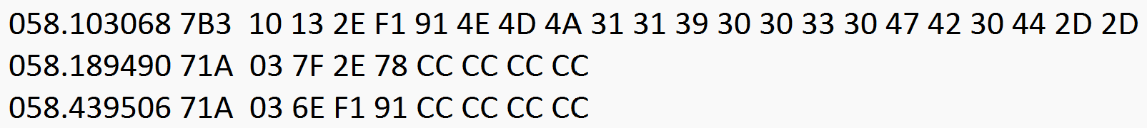
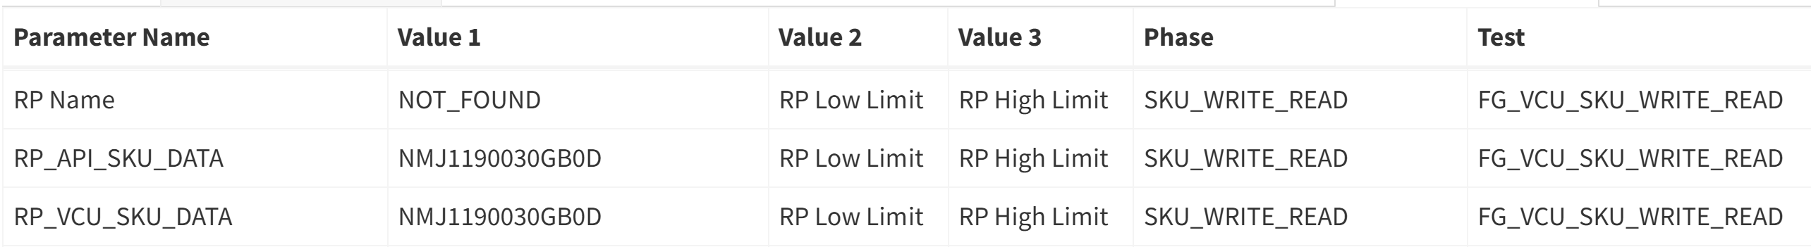
Test Verification
VCU – Write SKU:
Log File:
Request
Response
Report Logiq:

Slide 29
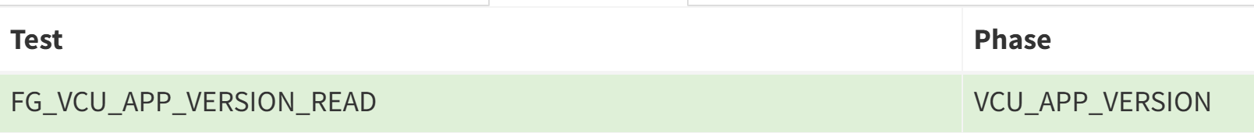
Test Verification
VCU – Read VCU Application Version:
Log File:
Report Logiq:

Slide 30
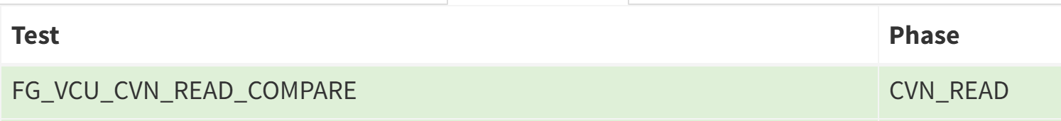
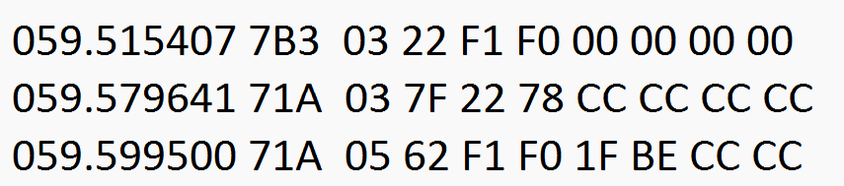
Test Verification
VCU – Read & Compare CVN:
Log File:
Request
Response
Report Logiq:

Slide 31
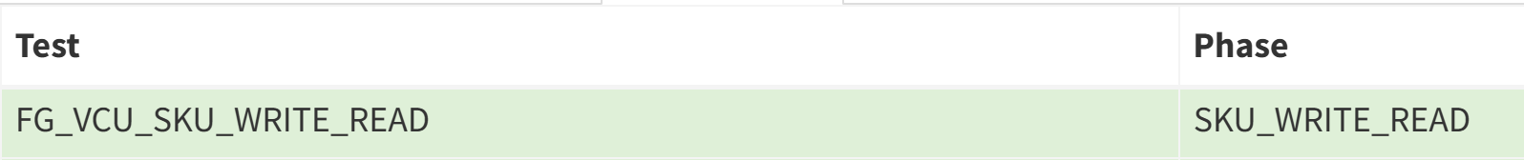
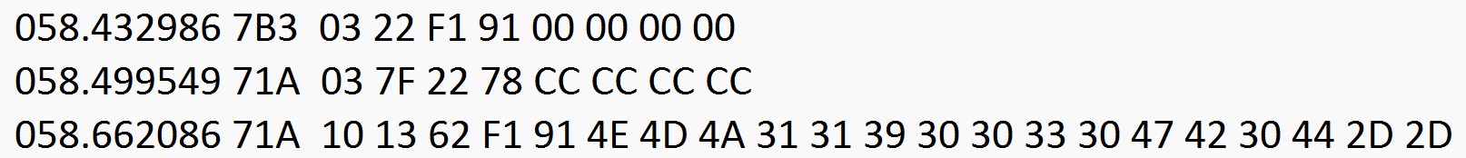
Test Verification
VCU – Read SKU:
Log File:
Request
Response
Report Logiq:

Slide 32
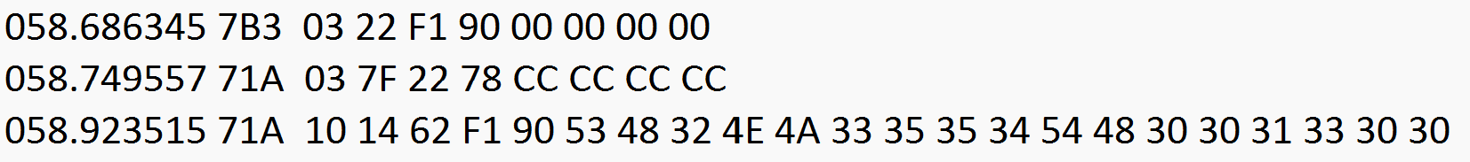
Test Verification
VCU – Read VIN:
Log File:
Request
Response
Report Logiq:

Slide 33
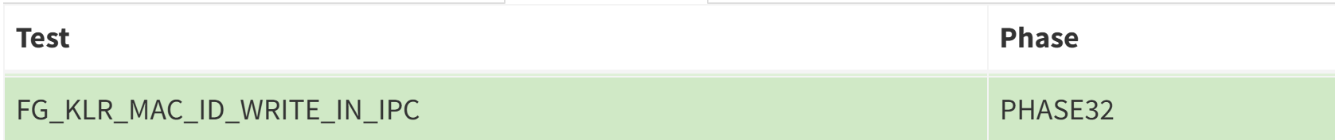
Test Verification
VCU – Write Key Fob MAC ID into Cluster:
Log File:
Request
Response
Report Logiq:

Slide 34
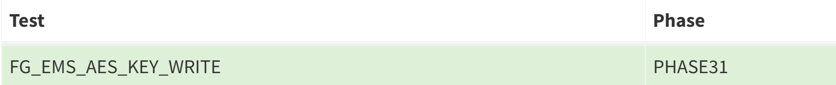
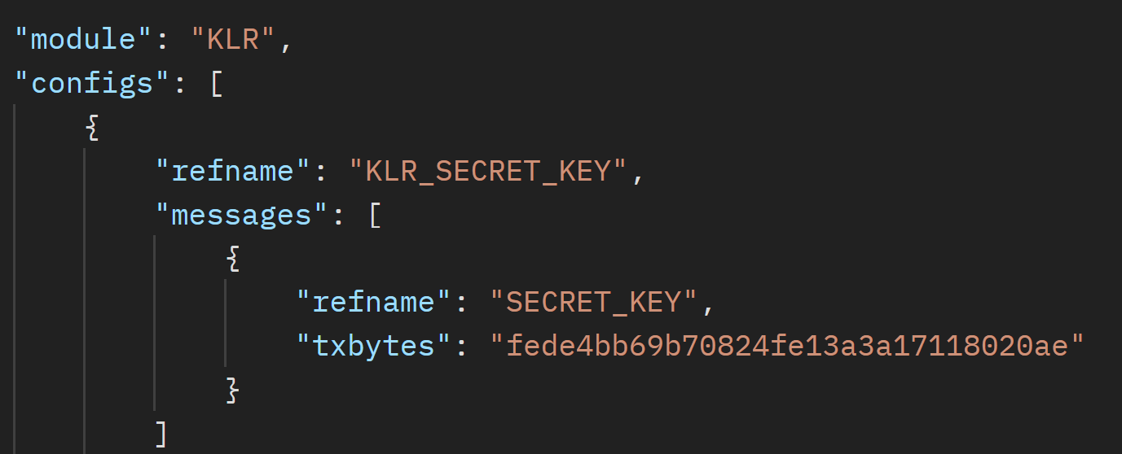
Test Verification
VCU – Write Key Fob Secret Key into EMS:
Log File:
EOL API Data:

Slide 35
Test Verification
VCU – Write Key Fob Secret Key into IPC:
Log File:
EOL API Data:

Slide 36
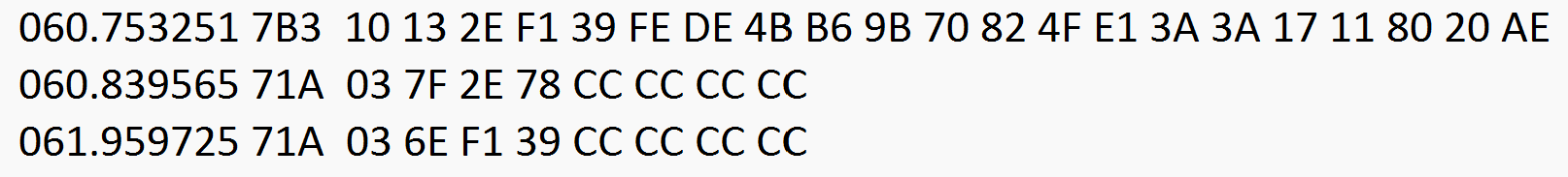
Test Verification
VCU – Write Key Fob Secret Key into VCU:
Log File:
EOL API Data:

Slide 37
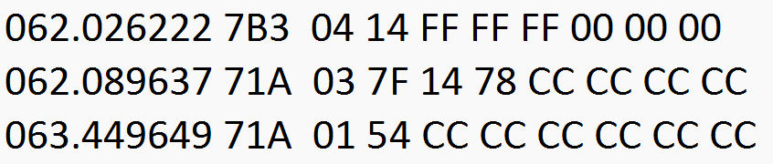
Test Verification
VCU – Clear DTC:
Log File:
Request
Response

Slide 38
PCM FLASHING

Slide 39
PCM Flashing Sequence
Expected Cycle Time: 4.5 to 5min
Start
Connect Cable
Ignition ON
Scan VIN number
Set PCM Station = Null
Check ABS & VCU Flashing = OK
Control DTC
Settings
Communication Control
Diagnostic Session control
Get PCM Flash
File details
Get Vehicle Data thru API
Start Comm.
PCM Flashing
PCM Extended
Diag Session
Cluster Software version check
Read Hardware version
Read & Compare CAL ID
Write VIN
Clear DTC
IMMO Enable
QS Enable
Read PCM Test Stamp
Write PCM Test Stamp
Read VIN
Read & Compare CVN
Log result
Send Result thru API
Stop

Slide 40
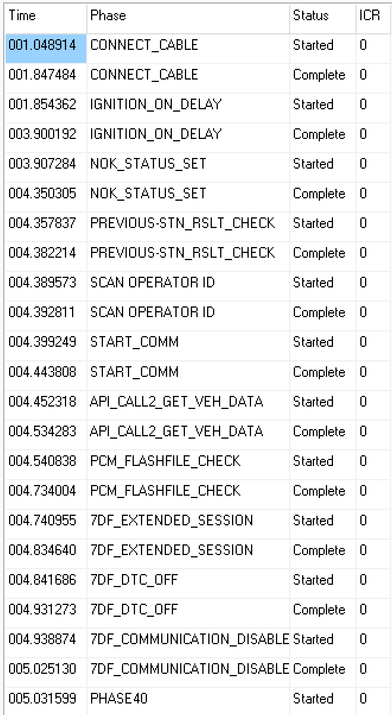
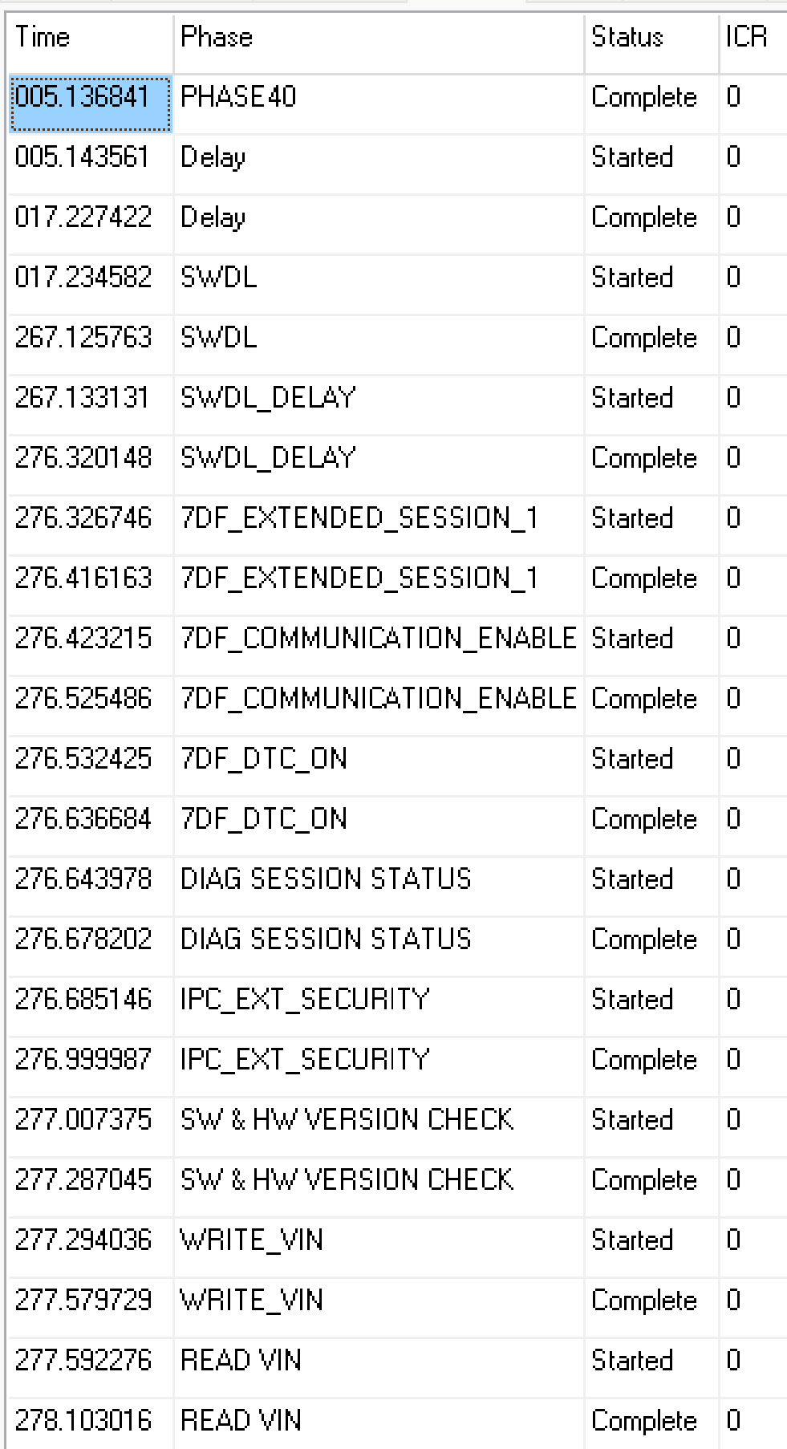
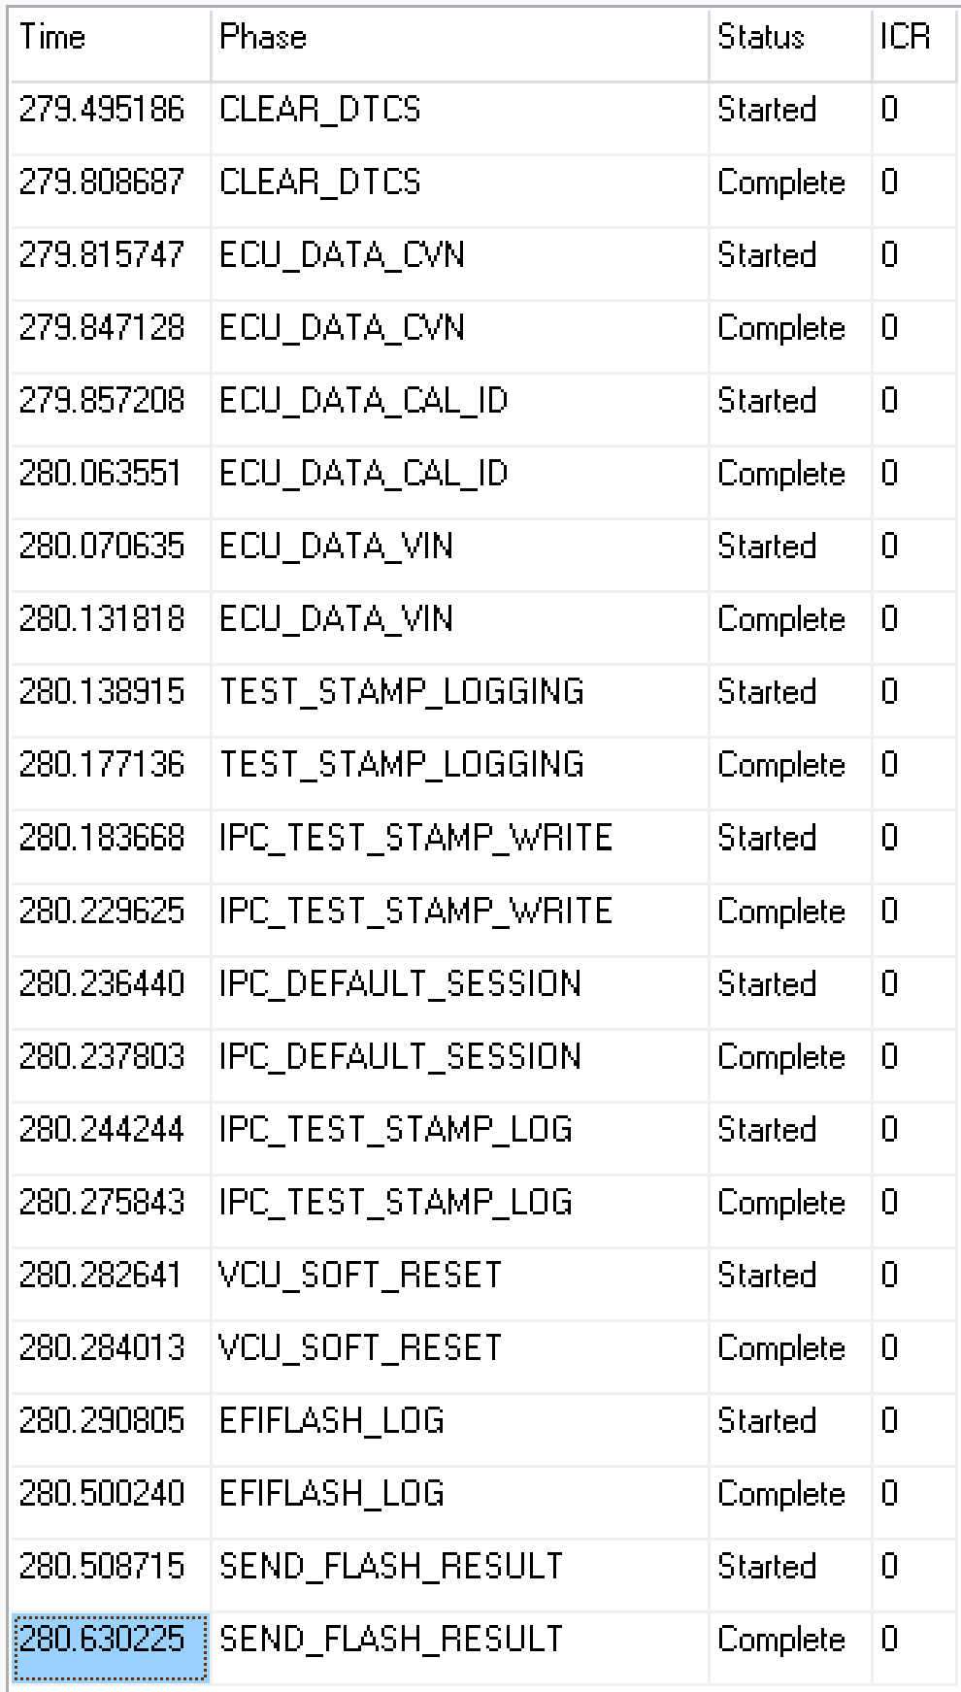
Test Verification - Phases

Slide 41
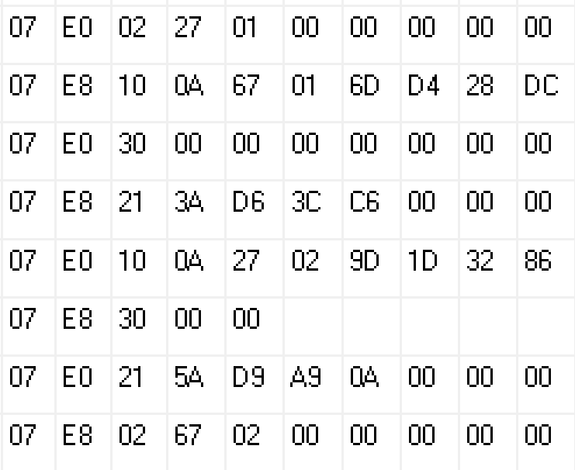
Test Verification
PCM – Seed & Key tests:
Log File:
Request
Response
Request
Response

Slide 42
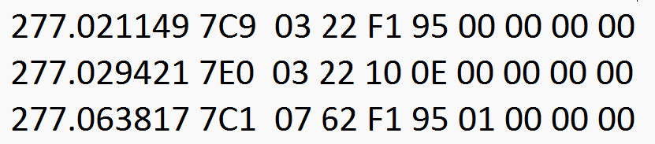
Test Verification
PCM – Read Cluster Software version:
Log File:
Request
Response
Report Logiq:

Slide 43
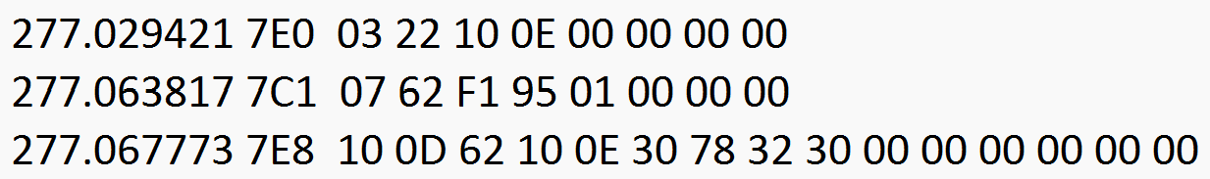
Test Verification
PCM – Read Hardware version:
Log File:
Request
Response
Report Logiq:

Slide 44
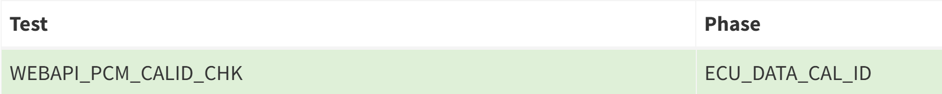
Test Verification
PCM – Read & Compare CAL ID:
Log File:
Request
Response
Report Logiq:

Slide 45
Test Verification
PCM – Write VIN:
Log File:
Request
Response
Report Logiq:

Slide 46
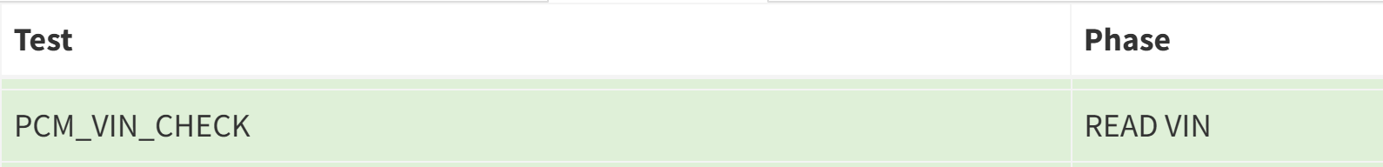
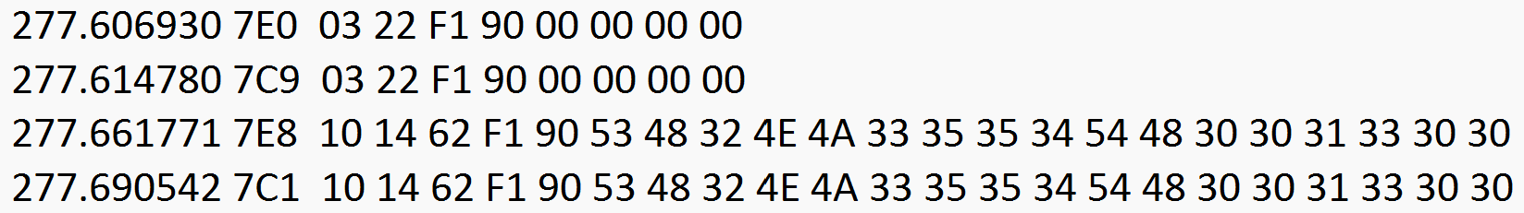
Test Verification
PCM – Read VIN:
Log File:
Request
Response
Report Logiq:

Slide 47
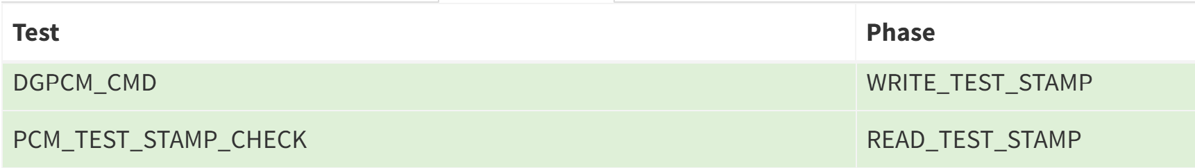
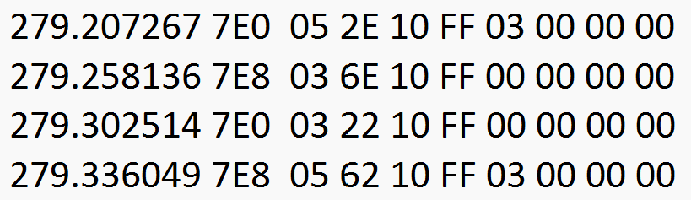
Test Verification
PCM – Write & Read test stamp:
Log File:
Request
Response
Report Logiq:

Slide 48


Test Verification
PCM – Quick Shift Enabling:
Log File:
Request
Response
Report Logiq:

Slide 49


Test Verification
PCM – IMMO Enable:
Log File:
Request
Response
Report Logiq:

Slide 50


Test Verification
PCM – Clear DTC:
Log File:
Request
Response

Slide 51


Test Verification
PCM – Read & Compare CVN:
Log File:
Request
Response
Report Logiq:

Slide 52
STATIC SEQUENCE

Slide 53
Static Sequence
Expected Cycle Time: 4.5 to 5min
Start
Connect Cable
Ignition ON
Scan VIN number
Set Static Station = Null
Check Flashing = OK
Activate Urban mode
Ride mode enable
Read Running mode
Write Running mode
Read EMS test stamp
Start Comm.
Activate Rain mode
Activate Tour mode
Activate Sport mode
Activate Enduro mode
Activate Urban mode
Read QS Enable status
Read VIN
Read e SIM status
Read SKU from Cluster
Write SKU into Cluster
Read Variant data (Base Only)
Write Variant data (Base Only)
Clear DTC
Write ABS variant in IPC
Read IPC BT firmware
Read IPC BT MAC ID
Activate SET button
Activate BACK button
A
Read Cruise ON/OFF status
Read Cruise RESET status
Read Cruise SET status
Activate DOWN button
Activate UP button

Slide 54
Static Sequence
Expected Cycle Time: 4.5 to 5min
A
Activate Traction control button
Read Fuel level resistance
Read Engine temperature
Read Intake Air temperature
Read Oil temperature
Lambda correction upstream
Upstream lambda – Additive adaption
Upstream lambda – Multiplicative adaption
Read Photo sensor
Read Map sensor voltage
Read Neutral gear from IPC
Lambda Avg correction
Ambient pressure of EMS
Clutch switch status
Variant Control
Read APS 2 Output
Read APS 1 Output
Read Hazard switch status
Read Indicator switch status
Read Warning lights control
Read Clutch switch status
Read Kill switch status
Read Side stand status
IG Coil IO Control
Injector IO Control
Purge Valve IO Control
Actuate Fan relay
Read EMS CVN
Write TPMS MAC ID
B
Read Headlamp SW version
Read TPMS config status
Read DRL status
Read IMMO status
Write EOL mode

Slide 55
Static Sequence
Expected Cycle Time: 4.5 to 5min
B
High beam routine control
Write test stamp
Read DTC
Clear DTC
Read VIN
Stop
Update STRF flag
Log results
Steering lock check
Subjective Checks
Read SKU

Slide 56



Test Verification - Phases
Contd…

Slide 57



Test Verification - Phases
Contd…

Slide 58



Test Verification - Phases
Contd…

Slide 59



Test Verification - Phases
Contd…

Slide 60



Test Verification - Phases
Contd…

Slide 61


Test Verification - Phases

Slide 62


Test Verification
PCM – Read PCM test stamp:
Log File
Request
Response
Report Logiq

Slide 63


Test Verification
PCM – Write & Read PCM Running mode:
Log File
Request
Response

Slide 64


Test Verification
PCM – Write Ride mode status Enable:
Log File
Request
Response

Slide 65


Test Verification
PCM / ABS – Ride mode 1 (URBAN):
Urban Mode:
PCM – 01
ABS - 01
Log File
Request
Response
Report Logiq

Slide 66


Test Verification
PCM / ABS – Ride mode 2 (RAIN):
Rain Mode:
PCM – 01
ABS - 02
Log File
Request
Response
Report Logiq

Slide 67



Test Verification
PCM / ABS – Ride mode 3 (TOUR):
Tour Mode:
PCM – 02
ABS - 01
Log File
Request
Response
Report Logiq

Slide 68



Test Verification
PCM / ABS – Ride mode 4 (ENDURO):
Enduro Mode:
PCM – 03
ABS - 03
Log File
Request
Response
Report Logiq

Slide 69


Test Verification
PCM / ABS – Ride mode 5 (SPORT):
Sport Mode:
PCM – 02
ABS - 01
Log File
Request
Response
Report Logiq

Slide 70


Test Verification
PCM – Quick Shift Enable:
Log File
Request
Response

Slide 71


Test Verification
IPC – Write & Read Variant Data for Base SKUs:
Log File
Request
Response
Report Logiq

Slide 72



Test Verification
IPC – Write & Read SKU:
Log File
Request
Response
Report Logiq

Slide 73


Test Verification
IPC – Read & Compare IMEI no:
Log File
Request
Response
Report Logiq

Slide 74

Test Verification
IPC – Read & Compare ICCID 1:
Log File
Request
Response
Report Logiq

Slide 75


Test Verification
IPC – Read & Compare ICCID 2:
Log File
Request
Response
Report Logiq

Slide 76


Test Verification
IPC – Read e-Sim Status:
Log File
Request
Response

Slide 77

Test Verification
IPC – Write ABS Variant in Cluster:
Log File
Request
Response

Slide 78

Test Verification
IPC – Read Bluetooth Firmware Version:
Log File
Request
Response
Report Logiq

Slide 79



Test Verification
IPC – Read MAC ID of Bluetooth Chip:
Log File
Request
Response
Report Logiq

Slide 80


Test Verification
IPC – Read Mode selection status (SET):
Log File
Request
Response

Slide 81


Test Verification
IPC – Read Mode selection status (BACK):
Log File
Request
Response

Slide 82


Test Verification
IPC – Read Mode selection status (UP):
Log File
Request
Response

Slide 83


Test Verification
IPC – Read Mode selection status (DOWN):
Log File
Request
Response

Slide 84

Test Verification
IPC – Read Cruise SET button status:
Log File
Request
Response

Slide 85


Test Verification
IPC – Read Cruise RESET button status:
Log File
Request
Response

Slide 86

Test Verification
IPC – Read Cruise ON/OFF button status:
Log File
Request
Response

Slide 87


Test Verification
IPC – Read Traction control button status:
Log File
Request
Response

Slide 88


Test Verification
IPC – Read Fuel level sensor resistance:
Log File
Request
Response
Report Logiq

Slide 89


Test Verification
PCM – Read Engine temperature:
Log File
Request
Response
Report Logiq

Slide 90


Test Verification
PCM – Read Intake Air temperature:
Log File
Request
Response
Report Logiq

Slide 91


Test Verification
IPC – Read Neutral Gear position from Cluster:
Log File
Request
Response

Slide 92


Test Verification
PCM – Read Map sensor voltage:
Log File
Request
Response
Report Logiq

Slide 93


Test Verification
IPC – Read Photo sensor:
Log File
Request
Response
Report Logiq

Slide 94

Test Verification
PCM – Read Lambda multiplicative adaptation - Upstream Lambda Sensor:
Log File
Request
Response
Report Logiq

Slide 95

Test Verification
PCM – Read Lambda additive adaptation - Upstream Lambda Sensor:
Log File
Request
Response
Report Logiq

Slide 96


Test Verification
PCM – Read Lambda correction upstream – Cylinder 2 (Upstream lambda sensor):
Log File
Request
Response
Report Logiq

Slide 97

Test Verification
PCM – Read Lambda average correction – Cylinder 2 (upstream lambda sensor):
Log File
Request
Response
Report Logiq

Slide 98


Test Verification
PCM – Read Ambient Pressure of Engine ECU:
Log File
Request
Response
Report Logiq

Slide 99

Test Verification
PCM – Read Clutch switch status:
Log File
Request
Response

Slide 100

Test Verification
IPC – Read Variant control:
Log File
Request
Response
Report Logiq

Slide 101



Test Verification
PCM – Read APS Output 1&2:
Log File
Request
Response
Report Logiq

Slide 102



Test Verification
PCM – Read APS Output 1&2:
Log File
Request
Response
Report Logiq

Slide 103


Test Verification
PCM – Read Side Stand Sensor Voltage:
Log File
Request
Response

Slide 104


Test Verification
PCM – Read Kill Switch Status:
Log File
Request
Response

Slide 105


Test Verification
PCM – Read Clutch switch status:
Log File
Request
Response

Slide 106


Test Verification
IPC – Warning lights IO control:
Log File
Request
Response

Slide 107



Test Verification
IPC – Read Indicator Switch Status:
Log File
Request
Response
Request
Response

Slide 108


Test Verification
IPC – Read Hazard Switch Status:
Log File
Request
Response

Slide 109


Test Verification
PCM – IG Coil IO control:
Log File
Request
Response

Slide 110


Test Verification
PCM – Injector Coil IO control:
Log File
Request
Response

Slide 111


Test Verification
PCM – Purge Valve IO control:
Log File
Request
Response

Slide 112


Test Verification
PCM – Actuate Fan relay IO control:
Log File
Request
Response

Slide 113



Test Verification
PCM – Read & Compare EMS CVN:
Log File
Request
Response
Report Logiq

Slide 114



Test Verification
IPC – Write MAC ID for Front & Rear tire (TPMS):
Log File
Request
Response
Report Logiq

Slide 115


Test Verification
ABS – Write EOL mode:
Log File
Request
Response

Slide 116

Test Verification
PCM – Read IMMO status:
Log File
Request
Response

Slide 117


Test Verification
IPC – Read DRL status:
Log File
Request
Response

Slide 118


Test Verification
IPC – Read TPMS Config status:
Log File
Request
Response
Report Logiq

Slide 119



Test Verification
HLC – Read Headlamp Software Version:
Log File
Request
Response
Report Logiq

Slide 120




Test Verification
HLC – High beam routine control:
Log File
Low beam routine
High beam routine
Headlamp OFF routine

Slide 121


Test Verification
IPC – Write & Read test stamp:
Log File
Request
Response

Slide 122





Test Verification
PCM / ABS / VCU / IPC – Read DTC:
Log File
EMS
ABS
IPC & VCU

Slide 123


Test Verification
PCM / ABS / VCU / IPC – Clear DTC:
Log File
IPC
EMS
ABS
VCU

Slide 124
IMU SEQUENCE

Slide 125
IMU Sequence
Expected Cycle Time: 110 to 120 Sec
Start
Connect Cable
Ignition ON
Scan VIN number
Set IMU Station = Null
Check Static = OK
Read IMU EOL mode = 01
Write IMU EOL mode = 01
Clear DTC
ABS Extended Diag Session
ABS Diagnostic Session
Start Comm.
IG OFF
IG ON
IMU EOL Routine
Read Pitch angle
Read Lean angle
Write Pitch angle
IG OFF
Press Lock button
Press Seat Unlatch button
Press Bike finder button
Write IMU EOL mode = 01
Write Lean angle
IG ON
Press Unlock button
Read IMU EOL mode = 01
IMU EOL Routine
Read IMU EOL mode = 00
Read Pitch angle
Stop
Update IMU flag
Log results
Read IPC test stamp
Write IPC test stamp
Read Lean angle

Slide 126



Test Verification - Phases

Slide 127


Test Verification
ABS – Clear DTC:
Log File
Request
Response

Slide 128

Test Verification
ABS – Write IMU EOL mode:
Log File
Request
Response

Slide 129


Test Verification
ABS – IMU EOL routine:
Log File
Request
Response
Report Logiq

Slide 130


Test Verification
ABS – Read IMU angles:
Log File
Request
Response
Report Logiq

Slide 131


Test Verification
ABS – Write IMU angles:
Log File
Request
Response
Report Logiq

Slide 132

Test Verification
IPC – Read Bike finder button status:
Log File
Request
Response
Report Logiq

Slide 133


Test Verification
IPC – Read Seat Unlatch button status:
Log File
Request
Response
Report Logiq

Slide 134


Test Verification
IPC – Read Lock button status:
Log File
Request
Response
Report Logiq

Slide 135


Test Verification
IPC – Read Unlock button status:
Log File
Request
Response
Report Logiq

Slide 136


Test Verification
ABS – Read IMU EOL mode = 01 & 00:
Log File
Request
Response
Request
Response

Slide 137


Test Verification
IPC – Write & Read test stamp:
Log File
Request
Response

Slide 138
ABS BRAKE TEST SEQUENCE

Slide 139
DRIVE TEST SEQUENCE (RTB)

Slide 140
RVS TEST SEQUENCE

Slide 141
IMU Sequence
Expected Cycle Time: 110 to 120 Sec
Start
Connect Cable
Ignition ON
Scan VIN number
Set RVS Station = Null
Check DTRF flag = OK
Read Running in mode
Read & Compare ICCID 2
Read & Compare ICCID 1
Read & Compare IMEI
Read PCM test stamp
Start Comm.
Activate Urban mode
Activate Rain mode
Activate Tour mode
Activate Enduro mode
Activate Sport mode
Activate Urban mode
Read ABS CAL ID
Read EMS CVN
Press Seat Unlatch button
Press Bike finder button
Clear DTC
Read VIN
Read VCU CVN
Read DTC
Write Production mod
Read Production mode
Stop
Update IMU flag
Log results

Slide 142




Test Verification - Phases

Slide 143

Test Verification
PCM – Read EMS test stamp:
Log File
Request
Response
Report Logiq

Slide 144
Test Verification
IPC – Read & Compare IMEI no:
Log File
Request
Response
Report Logiq

Slide 145
Test Verification
IPC – Read & Compare ICCID 1:
Log File
Request
Response
Report Logiq

Slide 146
Test Verification
IPC – Read & Compare ICCID 2:
Log File
Request
Response
Report Logiq

Slide 147

Test Verification
PCM – Write & Read PCM Running mode:
Log File
Request
Response

Slide 148
Test Verification
PCM / ABS – Ride mode 1 (URBAN):
Urban Mode:
PCM – 01
ABS - 01
Log File
Request
Response
Report Logiq

Slide 149
Test Verification
PCM / ABS – Ride mode 2 (RAIN):
Rain Mode:
PCM – 01
ABS - 02
Log File
Request
Response
Report Logiq

Slide 150
Test Verification
PCM / ABS – Ride mode 3 (TOUR):
Tour Mode:
PCM – 02
ABS - 01
Log File
Request
Response
Report Logiq

Slide 151
Test Verification
PCM / ABS – Ride mode 4 (ENDURO):
Enduro Mode:
PCM – 03
ABS - 03
Log File
Request
Response
Report Logiq

Slide 152
Test Verification
PCM / ABS – Ride mode 5 (SPORT):
Sport Mode:
PCM – 02
ABS - 01
Log File
Request
Response
Report Logiq

Slide 153


Test Verification
PCM / ABS / IPC – Read VIN:
Log File
Request
Report Logiq
Response

Slide 154

Test Verification
PCM / ABS / IPC – Read VIN:
Report Logiq

Slide 155
Test Verification
PCM / ABS / VCU / IPC – Clear DTC:
Log File
IPC
EMS
ABS
VCU

Slide 156
Test Verification
IPC – Read Bike finder button status:
Log File
Request
Response
Report Logiq

Slide 157
Test Verification
IPC – Read Seat Unlatch button status:
Log File
Request
Response
Report Logiq

Slide 158


Test Verification
PCM – Read & Compare EMS CVN:
Log File
Request
Response
Report Logiq

Slide 159
Test Verification
ABS – Read & Compare CAL ID:
Log File:
Request
Response
Report Logiq:

Slide 160
Test Verification
VCU – Read & Compare CVN:
Log File:
Request
Response
Report Logiq:

Slide 161





Test Verification
PCM / VCU / ABS / IPC – Read DTC:
Log File:

Slide 162

Test Verification
IPC – Write & Read Production mode:
Log File:
Request
Response

Slide 163
THANK YOU

